Slide 1
Dreams, Dreaming and the Subconscious

Slide 2
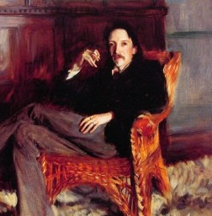

Slide 3
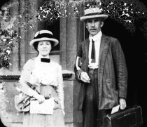
Sir Arthur Tansley, a botanist who later became a psychologist
famous for the idea that ecosystems are self-organizing

Slide 4
Marc Chagall, His paintings have a few distinct images in an unlikely association that would be bizarre in real life, but typical of images we see in dreams. Perhaps this spontaneity and ability to express a dream-world is why his work is so loved

Slide 5
Chagall, Cow with a parasol
Cows have different meanings to different people, in different cultures.
Any image will have a different meaning depending on the dreamer and the context.

Slide 6
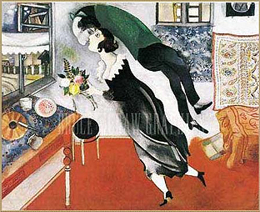
Sometimes we’re so happy we feel like we’re floating on air, like being in a dream

Slide 7
Left Brain Right Brain
http://psychology.about.com/od/sensationandperception/ig/Optical-Illusions/spinning-dancer-illusion.htm
http://www.heraldsun.com.au/news/right-brain-v-left-brain/story-e6frf7jo-1111114603615

Slide 8
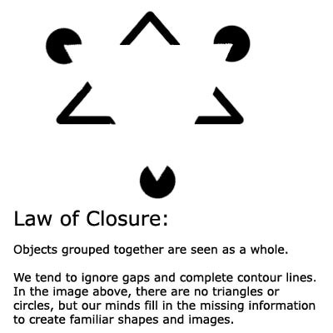
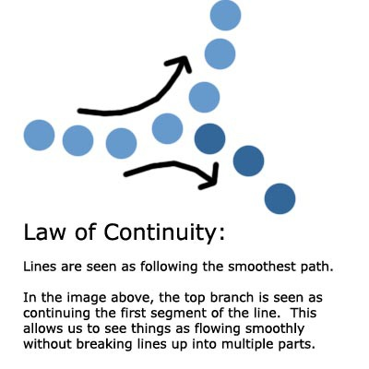
Confabulation: Psychology To fill in gaps in one's memory with fabrications that one believes to be facts.
Gestalt Laws of Perceptual Organization
Our brains often ignore contradictory information and fill in gaps in information.

Slide 9
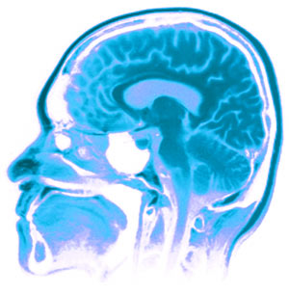
The Three Pound Universe What is this thing we call a brain?
Franklin Institute, Center for Innovation in Science :
a thinking organ
learns and grows by interacting with the world
learns by perception and action.
Mental stimulation improves brain function
The human brain is able to continually adapt
-Can rewire itself
-Has a 85 billion neurons
-can grow new neurons.
-use it or lose it.
Notes:
What is this thing we Call a brain?

Slide 10
Minds, Brains, and Machine
What do we have in common ?
What makes a Human different from a Computer?
Notes:
Jeff Hawkins vs Dr. Kristoff Koch (Brain Institute)
2011 Symposium at MIT
The importance of teamwork
At a panel titled “Social Cognition and Collective Intelligence,” scientists delved into the phenomenon of humans pooling their intelligence, sometimes aided by computers. Moderator Thomas Malone, director of MIT’s Center for Collective Intelligence, noted in his introduction that “intelligence is not just something that happens inside individual brains. It also arises within groups of individuals.”
For thousands of years, groups such as families, countries, armies and companies have been behaving in ways that seem intelligent. More recently, the Internet has expanded collective intelligence even further, with the development of sites such as Wikipedia and Google that make it easy to consolidate individual contributions.
Humans and computers working together can form a collective far more intelligent than any single person or computer, Malone said.
“As the world becomes more and more highly connected, through all kinds of electronic devices, it will be increasingly useful to think of all humans and computers on the planet as a single global brain,” he said.
_____________
Are we all robots? Is our DNA the 0's and 1's of computer code? Are we an advanced computer system, with instead of keyboard and mouse input... input from our senses. Our database being our brain to process all the information. Our offspring just a code merge from two existing chemical computers. Instead of a socket to run the CPU, we create are electricity from food. Do we make our own decisions or is our brain just advanced logical circuit board of if/else statements making decisions from the vast input our senses give us?
If there is a difference, what is it?

Slide 11
Minds, Brain, and Machine
Both:
Both use electrical pulses
Can communicate
Transmit information
Have memory that grows and can be expanded, supplemented
Adapt and learn
Evolve with time
Need Energy
Can be Damaged
Change and can be modified
Speak
What about thinking?

Slide 12
Coma means deep sleep-
but is it deep sleep?
Notes:
For a patient to maintain consciousness, two important neurological components must function.
The first is the cerebral cortex—the gray matter that covers the outer layer of the brain.
The other is a structure located in the brainstem, called reticular activating

Slide 14
Is it possible to share Thoughts and dreams?

Slide 15
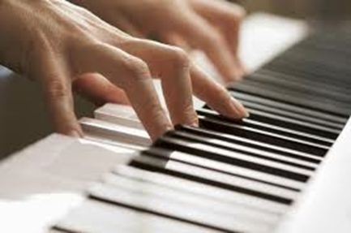
Clive Waring
He has no short-term memory but has implicit memory

Slide 16
Are you a dreamer?
http://www.youtube.com/watch?v=9yJE1iiO0qI

Slide 17
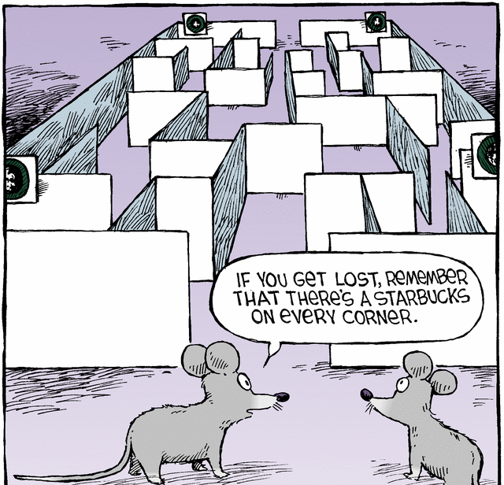
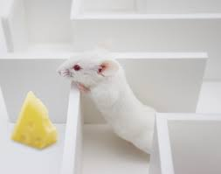
Theory (#2 of 6) Matt Wilson, MIT Center for Learning and Memory Dreams Create Wisdom
“Sleep turns a flood of daily information into what we call wisdom:
the stuff that makes us smart for when we come across future decisions”
we encode memory to long-term memory when we sleep
Dreams sort through memories, to determine which
ones to retain and which to lose.
His test: He put rats in mazes during the day & recorded what neurons fired in what patterns as the rats negotiated the maze. In REM sleep, the same neuron patterns fired that had fired at important turning points in the maze.
In other words, he saw that the rats were dreaming of important junctures in their day.

Slide 18
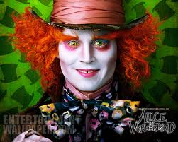
MRI: your brain watching a movie
Alice in Wonderland https://www.youtube.com/watch?v=1BWWkXdOui4&index=5&list=UUbDdmTlTwoCUx2p7nScbUCw
Avatar
http://www.youtube.com/watch?v=KSKIkXvqruI&list=UUbDdmTlTwoCUx2p7nScbUCw&index=4&feature=plcp

Slide 19
If a tree falls in your dream, why does it make a sound?

Slide 20
Memory
3 systems:
Short term- active memory
7 things
7 seconds – 30 seconds
Sensory- from senses and experiences
Long term- is stored memory
About 86 billion neurons in a brain
Explicit (declarative) Conscious
Implicit (procedural) Subconscious

Slide 21
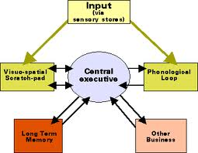
Memory
Working Memory
Central Executive, Prefrontal lateral cortex (PFC)
WM includes Short Term Memory
But not all memory goes
to long term Memory
Some memories are never in dreams- can you guess why??

Slide 22
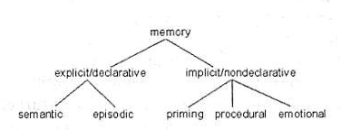
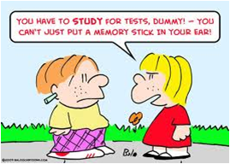
EXPLICIT MEMORY IS CONSCIOUS:
Explicit Memory is the deliberate recollection of a memory; we have to work to remember it. It’s specific, the kind of memory we think about or draw upon countless times a day
Episodic (long-term)
Specific
Autobiographical
Emotional
Includes flashbulb memory
Semantic (long term)
General knowledge
Not unique to individual

Slide 23
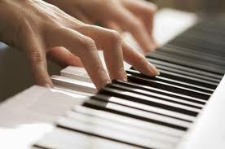
IMPLICIT MEMORY
LONG TERM MEMORY
SUBCONSCIOUS
Not specific
separate from explicit memory
operates through a different process in the brain
Procedural
Automatic sensorimotor behavior
(walking, playing a guitar, shooting baskets)
Emotional Memory (love, fear)
Automatic
Muscle memory (how to hold a pen)
Priming
How deep and how vast is our mind? Is that what dreams are?
Clive Waring: http://www.youtube.com/watch?v=Vwigmktix2Y

Slide 24
Sleep is important for memory
sleep before learning, is necessary because it prepares you to learn
the next day
sleep after learning is essential: it grabs onto the new information and cements the information in the neural architecture of the brain.
Sleep is like a save button, protects the memory and strengthens memory
Sleep intelligently cross links large sets of information, seeks out patterns, rules of all that information and creates novel insights.
Problem solving (the expression: sleep on it)
If sleep deprived, about 40% impairment in capacity to learn

Slide 25
Memory Systems
Synaptic consolidation- within a few hours of learning
(when awake)
Systems consolidation- over days, weeks, maybe months
(when we’re asleep)
Even years later
Memory reconsolidation and Updating consolidation

Slide 26
MEMORY TRIAGE: (Acquisition | consolidation)
While we sleep our brain processes new information in a discriminatory manner
it picks and chooses what to keep
assimilates the memory into a
vast library of evolving knowledge
Encoding and Sleep Consolidation
Not everything is remembered-
For information that is retained, sleep integrates it into existing memory by:
looks for common patterns
Consolidates memories
Or, simply cement and strengthen the memory exactly as it was learned

Slide 27
How does the brain choose what memory to consolidate?
“TAGS”
If not tagged, sleep will forget memories it decides you don’t need
How to make sleep cement a memory?
For example: If you think you will be tested, your brain will remember it
Tags might be:
emotional
you were excited about it
pleasurable
made you happy
When does sleep consolidate memory?
In stage 3 and 4 deep slow-wave sleep (Non-rem sleep)

Slide 28
OUR COLLECTIVE MEMORY
Three memories
1 flashbulb memory (explicit and specific)
1 semantics/ not important
1 procedural (implicit and general)

Slide 29
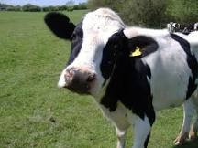
Dreams include images and memories
Episodic Memory
Memories which are actually perceived and known;
Specific
Autobiographical
Emotional, such as love, fear
Includes flashbulb memory
Procedural memory
Procedural is the steps to doing something, or learning to do it
Procedural memory includes muscle memory (how to play piano)
Semantics
general knowledge, NOT unique to individual
symbols and meanings that the symbol emotes
long term memory and implicit
Perceptual memory
Conceptual memory
Abstract
Notes:
1. Episodic
Memories which are actually perceived and known;
For Ex: An actual memory of riding your bike to school
the day you almost got hit by a car. A distinct memory/event
2. Procedural memory
Procedural is the steps to doing something, or learning to do it; Learning How to ride a bike
3. Semantics
Semantics are long term memory;
it is the symbols and meanings that the symbol emotes (with a feeling), or connects in general to something, but not an actual specific experience or a specific thing.
Semantics are general knowledge
Dreams are filled with metaphors and semantics mixed in with episodic memory and learning
Think of everything we put into our brain, (some of it is your thoughts and some is not. Some is nonsense and some is not) and then think about what ends up in your dreams)

Slide 30
Calvin Hall: Dreams are a cognitive process
The goal is not to understand the dream-
But to understand the dreamer
Analyzed thousands of dreams from diaries
Developed a quantitative coding system for content
Looked for patterns
Methodical, empirical
Believed meaningful predictions could be made about
dreamer’s behavior and lifestyle
Dreams provide a path to the unconscious areas of the mind,
and can be a map for the dreamer to anticipate difficulties and obstacles

Slide 31
One picture is worth a thousand words
A dream is a work of art
Metaphor isn’t necessarily a metaphor
It can be a pun or a slang
He didn’t think dreams were a disguise
not hidden expression
Dreams provide a path to the unconscious areas of the mind,
and can be a map for the dreamer to anticipate difficulties and obstacles

Slide 32
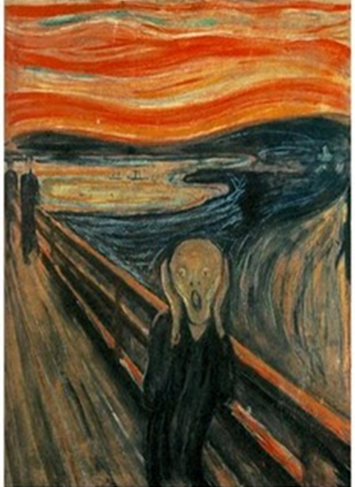
Calvin Hall: Dreams are a cognitive process
Concepts of Self
refer to the types or number of roles you play in your dreams
Concepts of other people are the roles other people play
in your dreams. Consider your feelings toward them and how
you interact with them
Concepts of the world represent the dream surrounding
and landscape. The adjectives you use to describe your
dreamscape is how you view the world.
Concepts of impulses, prohibitions and penalties
indicate your behavior and how it is ruled by impulses and
punishment.
Concepts of problems and conflicts symbolize your
struggles, issues and problems you are facing in your waking life.
Dream try to offer insight and resolution to your conflicts.

Slide 33
Quick break if you want…
And making a dream
Learning to Fly live : 5 minutes http://www.youtube.com/watch?v=4p_f7Df2-oM&feature=related

Slide 34
DREAM Theory (#3 of 6) Francis Crick: Nobel in Physiology for discovering structure of DNA Dreaming is Like Defragmenting Your Hard Drive
"we dream in order to forget."
The brain is a machine that connects data in the same way as a matter of habit, (not always useful to do this)
When we sleep the brain fires more randomly and establishes new connections and pathways
Dreaming shuffles old connections that allows us to keep the important connections and erase the inefficient links
A good analogy here is the defragmentation of a computer's hard drive: Dreams are a reordering of connections to streamline the system

Slide 35
Where the wild things are
http://www.traileraddict.com/trailer/where-the-wild-things-are/feature-trailer

Slide 36
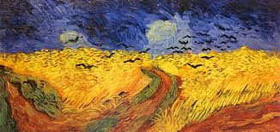
Vincent Van Gogh: Wheat Field with Crows, 1890 Akira Kurowsawa: Crows, 1990
“You're an artist, aren’t you?”
Has music by Enya: https://www.youtube.com/watch?v=sJ90m9y4fx8&feature=related
https://www.youtube.com/watch?v=TgSIRjyQOgA

Slide 37
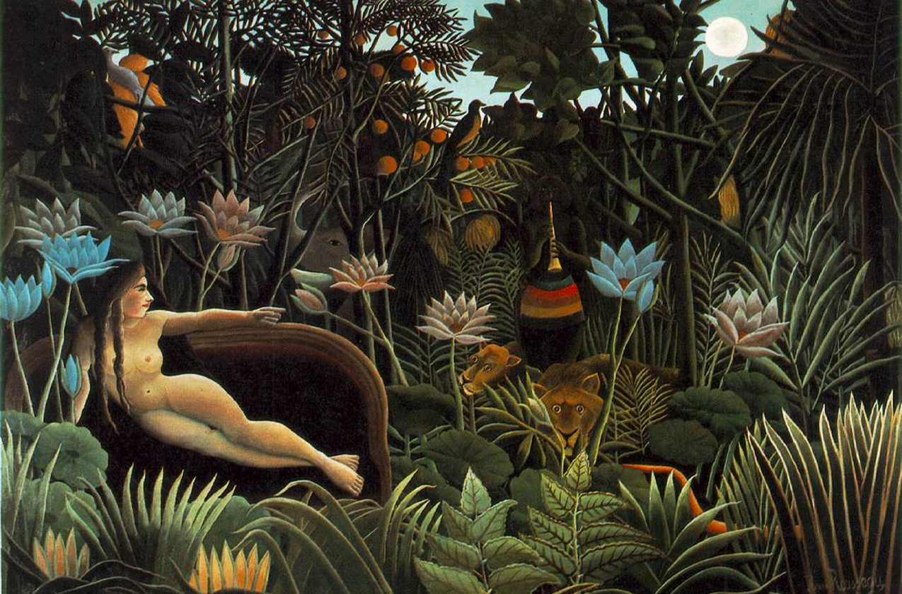
Henri Rousseau, The Dream, 1910 Rousseau never went to Africa, but at the time, travel books were very popular and widely read, not unlike we watch tv today as entertainment.

Slide 38
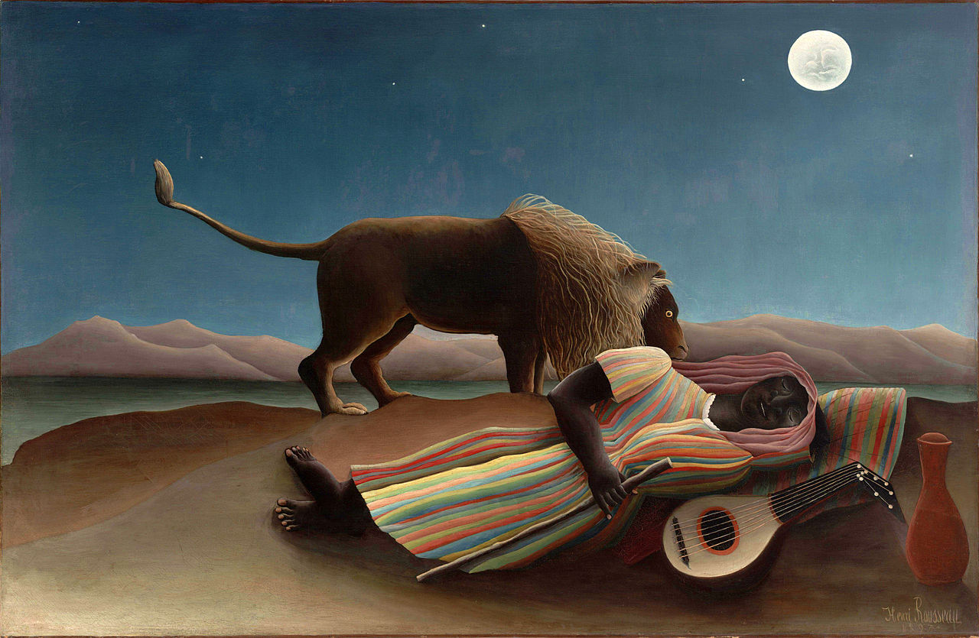
Henri Rousseau, the sleeping gypsy, 1897

Slide 39
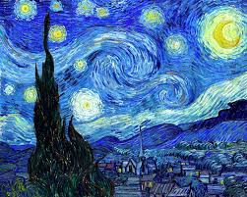
Vincent Van Gogh: Starry night, 1889
it depicts the night-time view outside his sanatorium window in Saint-Remy-de province

Slide 40
How to remember your dreams?
keep a dream journal

Slide 41
a Dream journal
Art, words, ideas, problems, conversations
Carl Jung: Boat with a Mandala

Slide 42
Philemon
Carl Jung’s spirit Guide
Dream helper

Slide 43
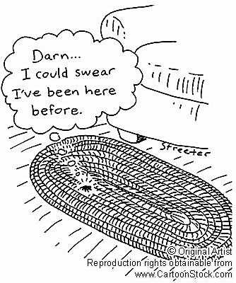
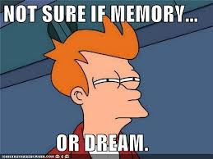
Deja Vu
Schema
Encoding
Confabulation
Precognition
Flow/ astral plane

Slide 44
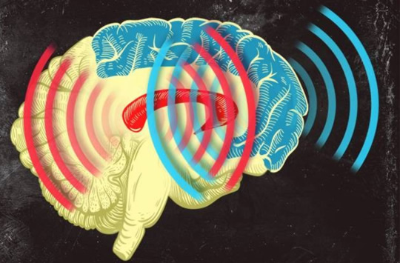
Synchronized Brain Waves enable rapid learning; new research 2014
Professor Earl K. Miller, MIT neuroscientist,
“If you can change your thoughts from moment to moment, you can’t be doing it by constantly making new connections and breaking them apart in your brain. Plasticity doesn’t happen on that kind of time scale.
There’s got to be some way of dynamically establishing circuits to correspond to the thoughts we’re having in this moment, and then if we change our minds a moment later, those circuits break apart somehow.” Category-learning results in new functional circuits between these two areas, and these functional circuits are rhythm-based…
When learning, the brain produces beta waves.
The striatum activates first, sees the pieces of the puzzle, then the prefrontal cortex puts the pieces together, working in sync with the striatum.
Prefrontal Cortex (blue)
& the Central Executive
Striatum (red)
Memory formation
Notes:
When learning, the brain produces beta waves. The striatum activates first, sees the pieces of the puzzle, then the prefrontal cortex acts and puts the pieces together, working in sync with the striatum. Category-learning results in new functional circuits between these two areas, and these functional circuits are rhythm-based,

Slide 45
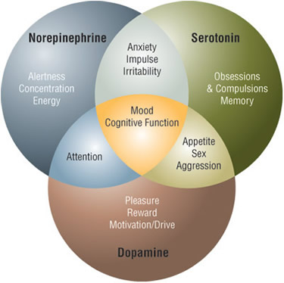
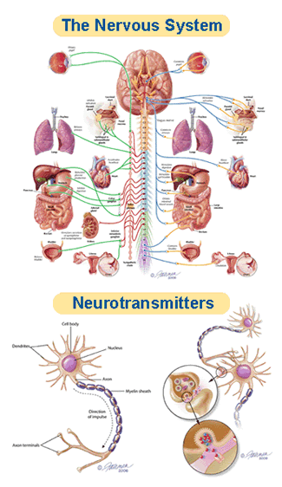
The Chemicals of Sleep… or not
Notes:
REM dreaming is characterized by low serotonin levels and high acetylcholine levels,(a neurotransmitter to the periphery and CN (central nervous system) norepinephrine
which may explain why dreams are so hard to remember: they are never encoded in short-term memory in the first place. When we wake up, serotonin floods the brain and our dream experiences from just a moment before are carried away by the tide.

Slide 46
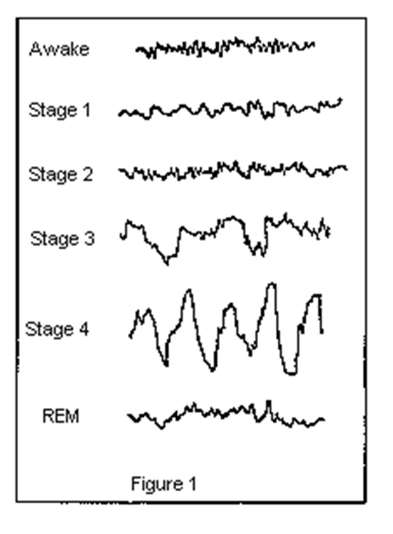
Brain waves

Slide 47
Chemicals and Sleep
neurotransmitters carry information between synapses
also control whether we are asleep or conscious
SEROTONIN: a neurotransmitter- our “happy hormone”
cognition
processes and carries memories
NOREPINEPHRINEN- ( noradrenaline) our “reward system”
Stress hormone| fight or flight (amygdala)
cognitive alertness, attention, concentration
MELATONIN- circadian rhythm: our natural clock
ADENOSINE: while we’re awake, it builds up & causes drowsiness
>breaks down as we sleep
DOPAMINE: a neurotransmitter, controls sleep regulation.
Dopamine acts in the pineal gland, dictating the 'circadian rhythm‘
controls the brain's reward and pleasure centers.
Dopamine also helps regulate movement and emotional responses,
Notes:
Nerve-signaling chemicals called neurotransmitters control whether we are asleep or awake by acting on different groups of nerve cells, or neurons, in the brain. Neurons in the brainstem, which connects the brain with the spinal cord, produce neurotransmitters such as serotonin and norepinephrine that keep some parts of the brain active while we are awake. Other neurons at the base of the brain begin signaling when we fall asleep. These neurons appear to "switch off" the signals that keep us awake. Research also suggests that a chemical called adenosine builds up in our blood while we are awake and causes drowsiness. This chemical gradually breaks down while we sleep.

Slide 48
Delta Waves
Females have more delta wave activity (true for most mammal species. )
Infants spend much of their sleep in Delta Wave sleep (25% less age 10)
Delta Wave sleep decreases with age
delta waves show a lateralization, with right hemisphere dominance during sleep
Delta waves arise in the thalamus or in the cortex.
Delta activity stimulates the release of several hormones, including growth hormone releasing hormone GHRH (somatocrinin) and PRl (prolactin) GHRH is released from the hypothalamus which in turn stimulates release of the growth hormone from the pituitary
Intoxication decreases delta waves: delta wave disruption
Schizophrenics have much less delta wave activity

Slide 49
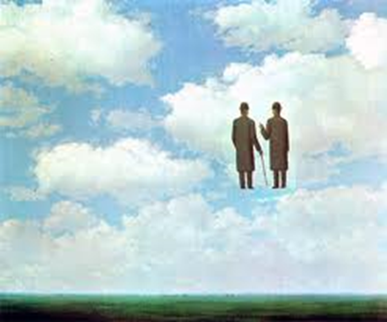
Your internal GPS system | Positioning tracking
Grid cells and Place cells
Fantastic for left and right, but not up and down
They make a mental map of our environment

Slide 50
changes while we sleep
NREM stages
Body temperature drops, body relaxes
Metabolism drops, blood pressure drops
Immune systems kick in, growth hormones
Electro-chemical changes
serotonin, epinephrine and melatonin
REM
Pons activates the switch
Intense brain activity
Rapid breathing, Increase blood pressure and heart rate
REM paralysis
PFLC shuts off
No working memory
No serotonin and no noradrenalin
Activation synthesis

Slide 51
Dream Theory # 1 The Evolutionary Theory We Dream to Practice Response to Situations Antti Revonsuo
Activity of the amygdala increases
The brain fires as if it’s in a
real life situation
The brain activity for motor skills increases- firing in a way that it’s practicing motor skills like running or jumping
In the safety of night, we practice survival skills
We rehearse fight or flight situations

Slide 52
Why are dreams weird?

Slide 53
Stages of sleep: Non-REM
N1 - hypnic myoclonia
(similar to when we jump when startled)
N2- hypnogogic imagery
N3- Deep sleep- slow delta waves start
growth hormones
N4 Deepest Sleep
Delta-waves
Difficult to wake
Bed-wetting
Night terrors
Sleep walking
Growth hormones for children & young adults
Immune System kicks in
Repairs damages (inc. those caused by stress)
Beauty sleep
Consolidate memory
Encode memory (improves learning ability)
Sleep amnesia- we don’t remember phone calls, alarms, etc.
Dream science experts believe most dreams are during REM sleep
Notes:
One cycle is about 90 minutes:
N1 Our eyes move very slowly and muscle activity slows. People awakened from stage 1 sleep often remember fragmented visual images. Many also experience sudden muscle contractions called hypnic myoclonia, often preceded by a sensation of starting to fall. These sudden movements are similar to the "jump" we make when startled.
REM: The first REM sleep period usually occurs about 70 to 90 minutes after we fall asleep. A complete sleep cycle takes 90 to 110 minutes on average. The first sleep cycles each night contain relatively short REM periods and long periods of deep sleep. As the night progresses, REM sleep periods increase in length while deep sleep decreases. By morning, people spend nearly all their sleep time in stages 1, 2, and REM.
Amnesia: People awakened after sleeping more than a few minutes are usually unable to recall the last few minutes before they fell asleep. This sleep-related form of amnesia is the reason people often forget telephone calls or conversations they've had in the middle of the night. It also explains why we often do not remember our alarms ringing in the morning if we go right back to sleep after turning them off.
Catching up on REM: People lose some of the ability to regulate their body temperature during REM, so abnormally hot or cold temperatures in the environment can disrupt this stage of sleep. If our REM sleep is disrupted one night, our bodies don't follow the normal sleep cycle progression the next time we doze off. Instead, we often slip directly into REM sleep and go through extended periods of REM until we "catch up" on this stage of sleep. What Does Sleep Do For Us?
Although scientists are still trying to learn exactly why people need sleep, animal studies show that sleep is necessary for survival. For example, while rats normally live for two to three years, those deprived of REM sleep survive only about 5 weeks on average, and rats deprived of all sleep stages live only about 3 weeks. Sleep-deprived rats also develop abnormally low body temperatures and sores on their tail and paws. The sores may develop because the rats' immune systems become impaired. Some studies suggest that sleep deprivation affects the immune system in detrimental ways.
Sleep appears necessary for our nervous systems to work properly. Too little sleep leaves us drowsy and unable to concentrate the next day. It also leads to impaired memory and physical performance and reduced ability to carry out math calculations. If sleep deprivation continues, hallucinations and mood swings may develop. Some experts believe sleep gives neurons used while we are awake a chance to shut down and repair themselves. Without sleep, neurons may become so depleted in energy or so polluted with byproducts of normal cellular activities that they begin to malfunction. Sleep also may give the brain a chance to exercise important neuronal connections that might otherwise deteriorate from lack of activity.
Deep sleep coincides with the release of growth hormone in children and young adults. Many of the body's cells also show increased production and reduced breakdown of proteins during deep sleep. Since proteins are the building blocks needed for cell growth and for repair of damage from factors like stress and ultraviolet rays, deep sleep may truly be "beauty sleep." Activity in parts of the brain that control emotions, decision-making processes, and social interactions is drastically reduced during deep sleep, suggesting that this type of sleep may help people maintain optimal emotional and social functioning while they are awake. A study in rats also showed that certain nerve-signaling patterns which the rats generated during the day were repeated during deep sleep. This pattern repetition may help encode memories and improve learning.

Slide 54
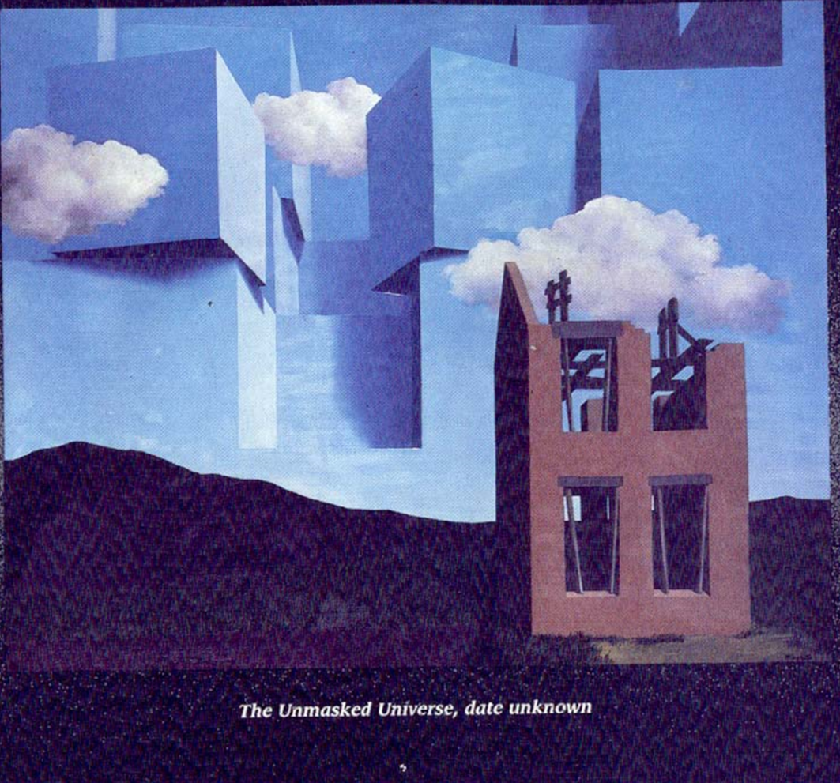
Hypnagogic Images or Hallucinations Hypnopompic Images (parasomnia- sleep disorder)
Notes:
Beethovan and Wagner wrote from this dream state
Thomas Edison, Nikola Tesla, Isaac Newton
Kehuli came up with Benzine from a dream state
"Painting ", wrote artist Rene Magritte, "reveals images of the world, and it can happen that in looking at them, painting them, thinking about them, we have this unfamiliar feeling of our mystic-self as we do when our eyes are closed." This emotion of the mystic-self, works like The unmasked Universe magritte a compatriot and contemporary of paul Delvaux-succeeds in capturing the startling, dream like mystery of which he spoke.

Slide 55
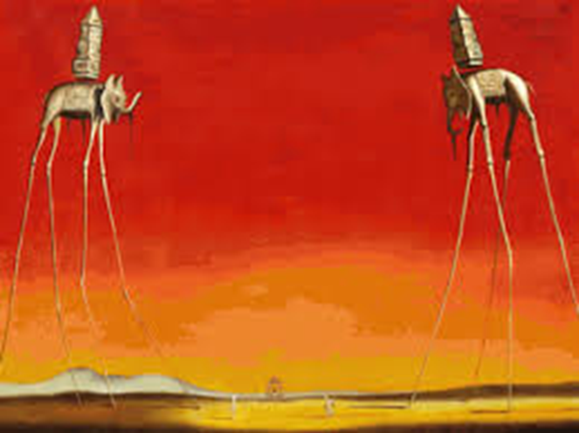
Salvador Dali

Slide 56
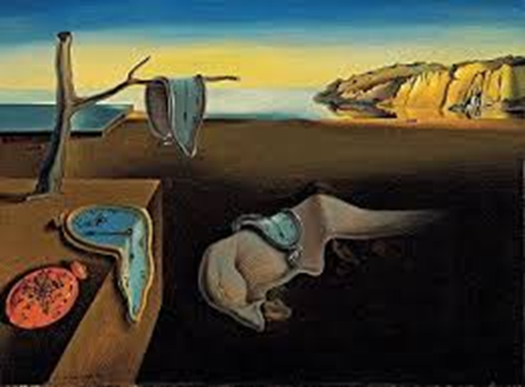

Slide 57
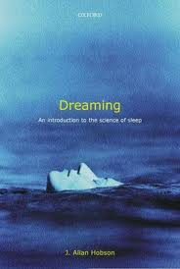
The Neuroscience of Dreams according to Hobson
Dr. J. Allan Hobson: Activation-Synthesis Hypothesis
Dreams are a neurochemical change in the brain
Erratic electric pulses from the brain stem
are cholinergic (use of acetylcholine as a neurotransmitter to send messages)
made of internally-generated visual imagery rather than taking in information from the senses
Random, no hidden meaning
Disputes Freudian dream theory
Supports Jungian theory
This Rift still exists in dream science today
Notes:
But what Hobson is really known for is sticking it to Freudian theory. In his break-out 1977 paper, Hobson and co-author McCarley declared victory over Freud (and the entire psychoanalytic community) by reporting their discovery that dreams in the REM state form by grace of neurochemical changes in the brain. As Kelly Bulkeley notes (1994), Hobson presented his work as a polemic against Freud, whose influence he accused of preventing scientific progress in the study of dreams. His central beef with Freudian theory is the notion that dreams are full of hidden messages by design. On the other hand, Hobson agrees with Jungian dream theory that dreams reveal more than they conceal, and can be quite transparent in significance
http://dreamstudies.org/2010/01/07/neuroscience-of-dreams/
One problem with Hobson’s original activation-synthesis model was that the theory presumes that all dreams occur in the REM state. However, two neuroscientists, James Foulkes and John Antrobus, have independently shown that long narrative dreams with bizarre elements can happen in non REM states too (see Rock 2004). Neuro-psychologist Mark Solms (1997) has also convincingly reframed the role of REM as an “alarm clock” for the mind to start dreaming, not as the prime creator. All of these researchers suggest that biochemical activation is not the sole genesis of a dream’s structure.

Slide 58
Allan Hobson Activation synthesis
Chaotic, spontaneous firings of neurons
There can be configurations/combinations that inspire great ideas
No hidden meaning
Meaningless, but as humans we want to give them meaning
The Limbic System
emotions are as important in dream genesis/structure
as brainstem activation
Lucidity
During lucidity the lateral prefrontal cortex becomes activated
The dream state and sleeping state are two separate dissociable states of the brain process
cognitive thought is another state

Slide 59
REM sleep
Necessary to survive
Necessary for brain development (even for infants)
REM Complex brain activity with delta waves
As active when we’re awake
Rapid and irregular breathing
Blood pressure rises
Body paralysis
No one knows why but the Pons shuts of the
PFC & Central Executive
sends signals to the Thalamus and the Cerebral cortex
During REM Sleep
the cortex tries to interpret the random signals from the Pons
the Limbic System remains active (the emotion center of our brain)
REM Sleep is when we dream
Notes:
One cycle is about 90 minutes:
N1 Our eyes move very slowly and muscle activity slows. People awakened from stage 1 sleep often remember fragmented visual images. Many also experience sudden muscle contractions called hypnic myoclonia, often preceded by a sensation of starting to fall. These sudden movements are similar to the "jump" we make when startled.
REM: The first REM sleep period usually occurs about 70 to 90 minutes after we fall asleep. A complete sleep cycle takes 90 to 110 minutes on average. The first sleep cycles each night contain relatively short REM periods and long periods of deep sleep. As the night progresses, REM sleep periods increase in length while deep sleep decreases. By morning, people spend nearly all their sleep time in stages 1, 2, and REM.
Amnesia: People awakened after sleeping more than a few minutes are usually unable to recall the last few minutes before they fell asleep. This sleep-related form of amnesia is the reason people often forget telephone calls or conversations they've had in the middle of the night. It also explains why we often do not remember our alarms ringing in the morning if we go right back to sleep after turning them off.
Catching up on REM: People lose some of the ability to regulate their body temperature during REM, so abnormally hot or cold temperatures in the environment can disrupt this stage of sleep. If our REM sleep is disrupted one night, our bodies don't follow the normal sleep cycle progression the next time we doze off. Instead, we often slip directly into REM sleep and go through extended periods of REM until we "catch up" on this stage of sleep.

Slide 60
What IS activated during REM ?
Melatonin, circada rhythm
Interpreting imagery
Limbic system: emotion center- pleasure center
Long-term memory consolidation & retrieval
Hippocampus:
spatial memory
Moves short term memory to long term memory
Amygdala
activates emotional learning,
fear conditioning
Anterior Cingulata
Mediates
Attention
Motivation
Lucid dreaming

Slide 61
REM: what is Not activated
Prefrontal lateral cortex
Central Executive
Organization
Planning
Tasks
Thinking
reasoning
Vision
No serotonin, noradrenalin/epinephrine
No social filter
Words and language

Slide 62
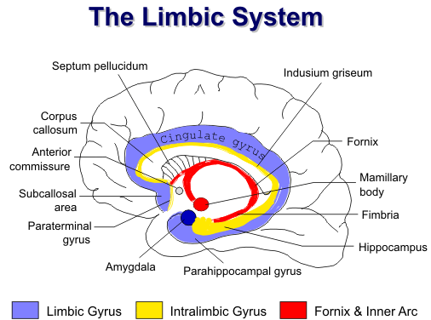
The Pleasure Center of the Brain
Emotional Center
Notes:
Phylogenetically, the limbic system is one of the more primitive parts of the brain. It has a central role in memory, learning, emotion, neuroendocrine function, and autonomic activities. Clinical conditions involving the limbic system include epilepsy, congenital syndromes, dementias, and various psychiatric disorders

Slide 63
Thalamus:
During REM sleep,
the thalamus stops
sending sensory signals
to the brain
the brain’s switchboard for information
responsible for awareness
puts the brain into sleep mode
regulates sleep, and wakefulness
If damaged can result in irreversible coma

Slide 64
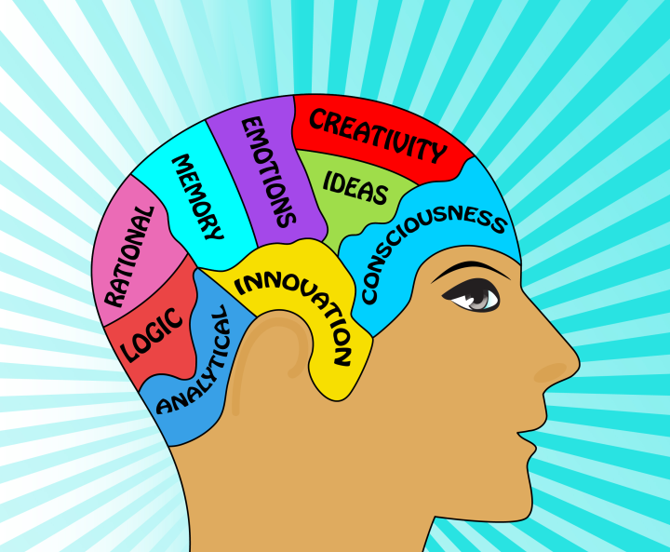
Amygdala
Formation and storage of emotional memories
Fear conditioning
Emotional response
Sleep can ‘soften’ harsh memories
People with posttraumatic stress disorder suffer from an overactive amygdala and an underactive anterior cingulate cortex
Is PTSD a sleep disorder?
Dream revision:
recurrent nightmares can be
eliminated by changing their ending
Notes:
People with PTSD don’t get enough sleep. Therefore, if they can get more sleep, will this help reduce the stress, and the PTSD…
A possible brain mechanism for PTSD is that trauma causes excessive amounts of norepinephrine (adrenaline) activation in the brain, which overloads the system, thereby preventing normal dreaming and normal memory formation from occurring.
The goal in PTSD treatment is to reduce activity in the amygdala and to increase activity in the ACC. Dream revision therapy may calm the amygdala by providing soothing input from the ACC. The frightening nightmare is changed so it is not so frightening or anger-provoking. The goal of dream revision is to empower the dreamer to take charge of their nightmare and make it more manageable. That is, the goal is to change the dreamer from trauma victim to trauma survivor.

Slide 65
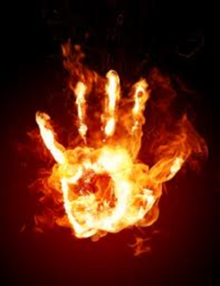
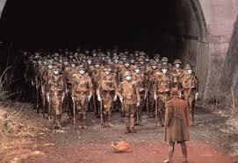
Cingulate
The mediator
How we dream ourselves out of a nightmare
Guides reward-based decisions

Slide 66
Nightmares and Dream Revision
Change the ending to dream ourselves
out of a nightmare
Harry Potter- The Ridikulous Spell
http://www.youtube.com/watch?v=Ps3cJksVMXw

Slide 67
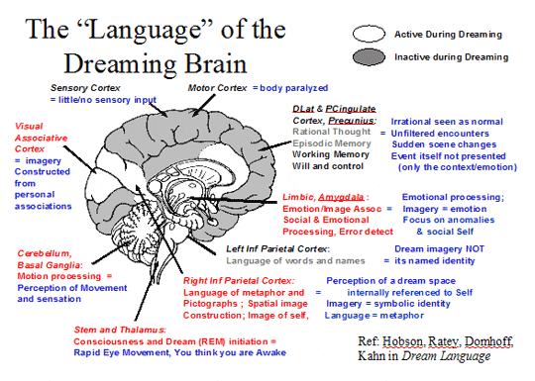
Notes:
The four stages of sleep during which the sleeper does not experience rapid eye movement (REM) sleep. They average sleep cycle lasts about 90 to 100 minutes. Non-REM dreams are more likely to consist of brief, fragmentary impressions that are less emotional and less likely to involve visual images than REM sleep dreams.
What exactly is the difference between REM & Non-REM Sleep?
REM Dreams and Non-REM dreams are very different from each other in a few major ways.
-Non-REM dreams consist of brief, fragmentary impressions.
-NREM less likely to involve visual images compared to REM sleep,
-more frequently forgotten.
Non-REM dreams are like thinking about something during the day for a brief period of time
Non-REM sleep lasts about four to six hours
REM dreams are comparable to thinking deeply about something.
REM sleep consists of about two hours a night while.

Slide 68
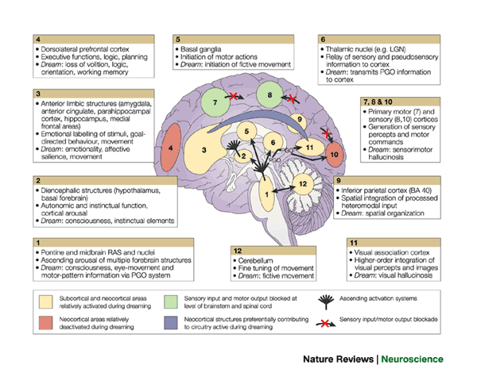
Notes:
From Hobson:
Regions 1 and 2, ascending arousal systems; 3, subcortical and cortical limbic and paralimbic structures; 4, dorsolateral prefrontal executive association cortex; 5, motor initiation and control centres; 6, thalamocortical relay centres and thalamic subcortical circuitry; 7, primary motor cortex; 8, primary sensory cortex; 9, inferior parietal lobe; 10, primary visual cortex; 11, visual association cortex; 12, cerebellum. BA, Brodmann area; LGN, lateral geniculate nucleus; PGO, ponto-geniculo-occipital; RAS, reticular activating system. Anatomical image adapted, with permission, from Ref. 129 © 1996 Appleton & Lange.

Slide 69
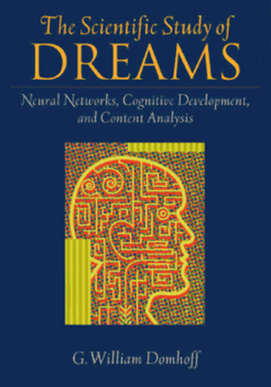
based on large amounts of data, his research shows
Dreams are consistent over time and reveal our conceptions and concerns.
there is "continuity" between the content of dreams and waking life. They are what we might expect based on the individual’s life
dreams from cultures around the world tends to be fairly similar
(the exception is aggression)
Dreams reflect relationships with loved ones
The dreams of schizophrenics (compared to the norms) show they have comparatively little friendliness or striving, and few friends.

Slide 70
1. Dreams are Intense
Can be emotional, embarrassing, painful, terrifying- so much so it wakes us up
Most common emotions are:
Fear
Anxiety
Surprise
2. Dreams are Disorganized and Illogical
Ambiguous, inconsistent, bizarre
3. Illogical content
ideas of time, person and place don’t apply
natural laws are disobeyed
4. Strange content: but we accept it
Events like we’re stuck and can’t move
Flying
Time travel
Research on Senoi culture
regarding dreams

Slide 71
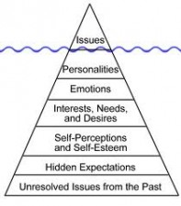
G. William Dumhoff Dreams Have Psychological Meaning & Cultural Uses, but No Known Adaptive Function
We are thinking creatures but that doesn't
mean that all forms of thinking have a function.
Evidence weights against any physiological or psychological function for dreaming and dreams.
Dreams do have meaning, and correlate with age, gender, culture, and personal preoccupations. "Meaning" has to do with coherence and with systematic relations to other variables, and in that regard dreams do have meaning.
Dreams are very "revealing" of what is on our minds.
His research showed that 75 to 100 dreams from a person are a very good psychological portrait of that individual.

Slide 72
Bill Dumhoff Current theories don’t explain why we dream. We need a new dream theory based on a neurocognitive theory of dreaming that includes:
Dreaming is a cognitive achievement that develops throughout childhood
There is a forebrain network for dream generation that is most often triggered by brainstem activation
Much of dream content is coherent, consistent over time and continuous with past or present emotional concerns.“
Sleep involves memory consolidation

Slide 73
Akira kurosawa
Kitsune
Dream helpers?

Slide 74
Parasomnia (sleep disorders)
Sleep talking (Somniloquy)
Sleep walking
Night Terrors
Narcolepsy
Sleep Paralysis
These happen when we’re partially awake, and ‘stuck’ between deep sleep and awake
may be hereditary
occurs more often with a fever

Slide 75
Kinds of dreams
Day dreams and imagination
Visions
Creative
Entertainment
Predicative/prophetic
Repetitive/recurring
Working out relationships/situations
Problem solving
Signal dreams
Epic
Healing/prodromic
Nightmares
Lucid
Flying
OBE
Astral
False awakening

Slide 76
MUSIC for listening Free falling john mayer live (great 4 minutes (10 sec, com) http://www.youtube.com/watch?v=20Ov0cDPZy8 Learning to Fly live : 5 minutes http://www.youtube.com/watch?v=4p_f7Df2-oM&feature=related sky sailing Brielle 4. minutes http://www.youtube.com/watch?v=_PkzsMak6P8&ob=nb_av2e In Dreams 2.5 minutes Roy Orbison http://www.youtube.com/watch?v=zbxsmcT7GOk MOVIE CLIPS/ USE FOR IMAGES and SYMBOLS
Eli stone http://www.youtube.com/watch?v=08tPHCdha34&feature=related
Harper Simon - Wishes and Stars http://www.youtube.com/watch?v=d82Dz1DW2BM&feature=related
1. Peach orchard esp. 3 minutes- 7 to understand http://www.youtube.com/watch?v=1qMqTZ-Jnbw&feature=related 2. Kurosowa w/ music from Enya. 3.5 minutes edited and merging of dreams with music by Enya Is Kuorsoawa asking himself: " Am i Van Gogh? " http://www.youtube.com/watch?v=sJ90m9y4fx8&feature=related
3. summary of movie DREAMS 2.5 minutes PHENEMOMINAL!!!!!! http://www.youtube.com/watch?v=oTRw66CnWLI&feature=related
Kurosowa Blizzard: Start at 2,50 – http://www.youtube.com/watch?v=5Af-DZkRyzk&feature=related
Part 3 trumpet music at 2,25 sees tent…
http://www.youtube.com/watch?v=cEDk5ysFiuw&feature=related
blizzard, not original - 7 minutes
http://www.youtube.com/watch?v=2TbDSi_K-FY&NR=1&feature=fvwp Billy Joel river of dreams http://www.youtube.com/watch?v=hSq4B_zHqPM

Slide 77
sources
Minds, Brains, Machine Larry Hardesty and Anne Trafton, MIT News Office May 9, 2011
http://newsoffice.mit.edu/2011/mit150-brain-ai-symposium
Synchronized Brain Waves Enable Rapid Learning; MIT 2014 Research:
http://newsoffice.mit.edu/2014/synchronized-brain-waves-enable-rapid-learning-0612
Memory: http://learnmem.cshlp.org/content/11/6/671.full

Slide 78
Starry Night, Don McLean https://www.youtube.com/watch?v=oxHnRfhDmrk
Enya; Kurosawa Dreams, Van Gogh- 3 minutes
https://www.youtube.com/watch?v=sJ90m9y4fx8&feature=related
Waking Life on Netflix
:http://video.google.com/videoplay?docid=7583894250854515095#
http://www.netflix.com/WiSearch?raw_query=&ac_category_type=none&ac_rel_posn=-1&ac_abs_posn=-1&v1=waking+life&search_submit=

Slide 79
Alfred Adler Founder of Depth Psychology w/ Freud and Jung
Not Repressed
Dreams reflect the person’s desire to have control over his own life
Dreams relate to your interests in life
Show ways to solve your problems
Dreams are an open pathway toward your true thoughts,
emotions and actions
Developed the Theory of Inferiority Complex
Developed the idea that men search to find meaning in their life
Notes:
To solve problems, shed understanding
They are problem-solving devices. Dreams need to be brought to the conscious and interpreted so that better understanding can be shed on your problems. It is important to learn from your dreams and
He was the first to leave
-he supported feminism, a difference from Freud
-believed anyone could apply psychology to help themselves

Slide 82
Sleepsong- lord of the rings
http://www.youtube.com/watch?v=VjbCp7w5Oww
10 strange facts
http://www.youtube.com/watch?v=ByBdGvh5E08
Kurosowa w/ music from Enya. 3.5 minutes edited and merging of dreams with music by Enya. Is Kurosoawa asking himself: " Am I Van Gogh? " http://www.youtube.com/watch?v=sJ90m9y4fx8&feature=related
summary of movie DREAMS 2.5 minutes PHENEMOMINAL!!!!!! http://www.youtube.com/watch?v=oTRw66CnWLI&feature=related

